Slide 1
Campaign Blueprint
A Data-Driven Strategy for Unlocking Customer Value in Online Retail

Slide 2
The Challenge & Our Objective
How can we move from a 'one-size-fits-all' marketing strategy to a data-driven approach that focuses our efforts on the right customers? Our objective is to use RFM analysis to segment customers into actionable groups and design targeted campaigns to increase their value.

Slide 3
The Business Landscape: A High-Level Overview
1
2
3
4
£8.2M+
~400k
4,319
1 Year
Total
Revenue
Total Transactions
Unique Customers
Time
Period

Slide 4
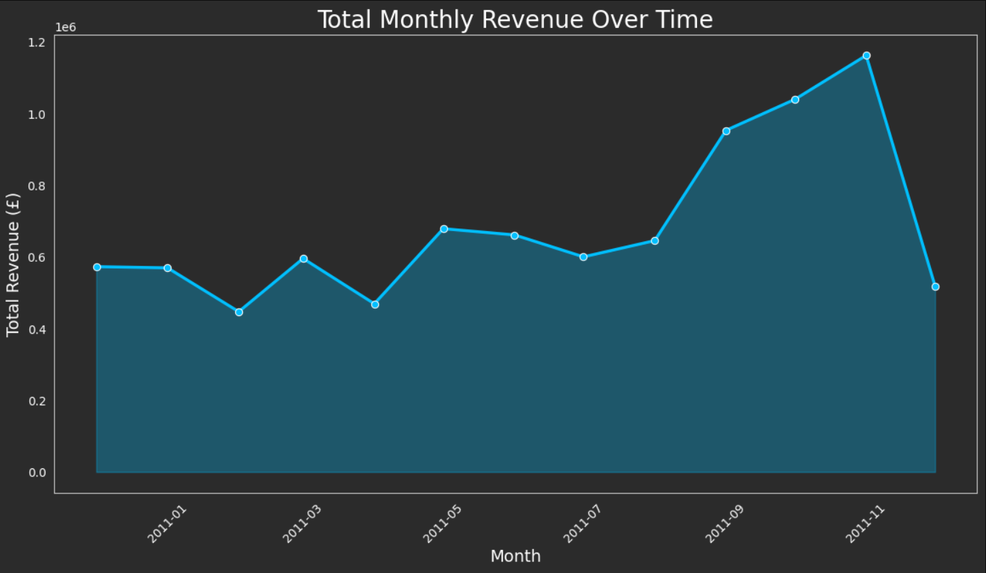
The Business is Driven by a Strong Seasonal Peak
The business shows a massive revenue spike in November, confirming the pre-holiday season is the most critical period for sales and customer acquisition.

Slide 5
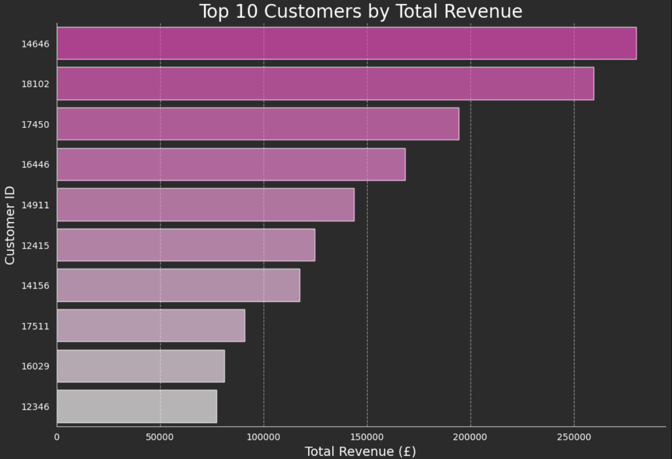
A Small Group of VIPs Drives a Huge Portion of Revenue
17%
….of all revenue comes from just the Top 10 Customers which is less than 0.25%
of the customer base

Slide 6
The Solution: Segmenting Customers with RFM Analysis
01
02
03
Calculate RFM
Analyze transaction data to get Recency, Frequency, and Monetary values.
Assign Scores
Use quantiles to convert raw values into a 1-4 score for each RFM dimension.
Create Segments
Sum the scores to create final, segments like "Champions" and "At Risk."

Slide 7
The Result: Meet Our Five Customer Personas
Our customer base is very healthy. Our two best segments, Champions and Potentially Loyal, make up a massive 67% of all customers.
37%
30%
12%
11%
10%
Champions
Potentially Loyal
Can’t Lose
At Risk
Lost

Slide 8
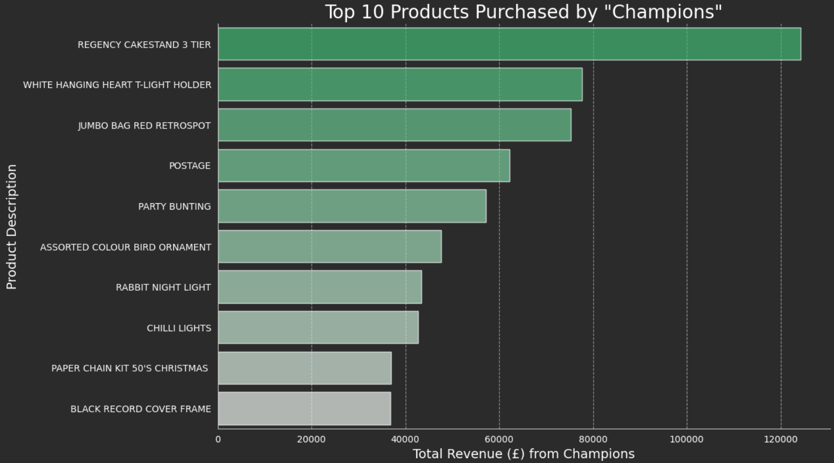
Our Best Customers Have Unique Tastes
The overall #1 best-seller is not in the Champions' Top 10. To engage our best customers, we must personalize.

Slide 9
A Targeted Campaign for Our "Champions"
Tactic 1:
Tactic 2:
Tactic 3:
“The Curated Welcome Offer”
"Complete the Look" Bundles
“The Inner Circle Program”
Goal:
Goal:
Goal:
Drive immediate sales & reinforce loyalty.
Increase Average Order Value (AOV) & product discovery.
Foster long-term loyalty & create brand advocates.
Execution:
Execution:
Execution:
A personalized discount on a product from their "Top 10" list that they haven't purchased yet.
Bundle products by affinity — e.g., 'Regency Hostess Set' with cake-stand and t-light holders.
Give exclusive early access to new collections, creating a sense of insider privilege.

Slide 10
Next Steps & How We'll Measure Success
Next Steps
Launch the "VIP Collection" email campaign.
Build a Market Basket Analysis.
Create a dashboard to track the following KPIs
KPIs
Increase in Purchase Frequency
Increase in Average Order Value (AOV)
Higher Customer Retention Rate

